Slide 1

BONIRY
Online Event Management System

Slide 2

EVENT MANAGEMENT SYSTEM
Event management is a strong and fast growing profession with a rather low level of standardization.
Event management is the application to manage and development of festivals, events and conferences.
Online event management system is an online event management system software project that serves the functionality of an event manager.
The system allow registered user login and new user are allowed to register on the application. The system helps in the management of events, users and the aspects related to them.
This proposed to be a web application. The project provides most of the basic functionality required for an event type e.g. [Marriage, Dance Show Birthday party,College Festival,etc.],

Slide 3

ABSTRACT
Event management is the application to manage and development of festivals, events and conferences. Proposed work involves study of identifying the target of budget, cost, and analysis. Post event analysis and ensuring a return on investment have become significant drivers for the event industry. This is an online event management system, software project that serves the functionality of an event manager. The project provides most of the basic functionality required for an event .It allows the user to select from list of event types. Events Management System is very helpful for events. This application being as a platform to know the events,to apply for the events. Event organizer is an application under project management for managing festivals or social events like gathering, colleges, events, conferences etc. To understand use of this application consider the flow of actions happening, by this application user can register the students, after registering, user can login, after login, event details including name ,contact, address, venue of the event, date, event conducting time, cost of events etc. After receiving SMS student can register through application.

Slide 4

WORKING
First the user has to register in the application and verify his/her identity via email.
Registered user can access by logging in through credentials.
It has different roles for a person like Admin,Manager,Volunteer,Guest.
Admin maintains the application and is in charge for privileges.
Manager is second in charge for the application and organizes the event.
Volunteer takes care of event and is able to update guest participants.
Guest is a normal user who can register in events.

Slide 5
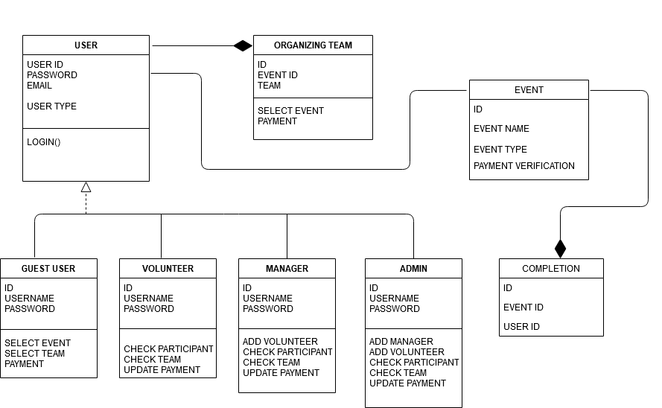
CLASS DIAGRAM

Slide 6
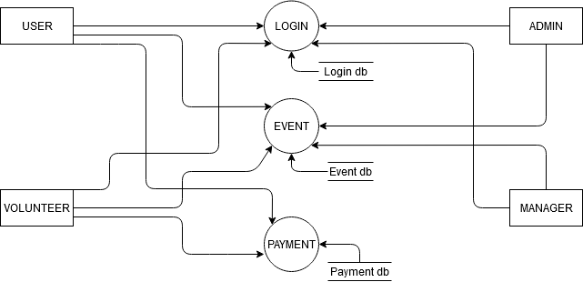
DATA FLOW DIAGRAM

Slide 7


ADVANTAGES
User Friendly GUI
This system is effective and provides best of the cost to user.
Save Time In Communication
Efficiently Manage Multiple Events

Slide 8



USES
Can be used in to organizing events in school & colleges.
Organizing Social Events. Etc.
To the creation and development of large scale events such as festivals, conferences, ceremonies, formal parties,concerts or conventions.
Event planning and which can include budgeting, scheduling, site selection, acquiring necessary permits, coordinating transport and parking.
Its involves studying the brand, identifying the target audience, devising the event concept, and coordinating the technical aspects before actually launching the event.

Slide 9




FRONT END VS BACK END
FRONT END
BACK END

Slide 10
ANGULAR
AngularJS: AngularJs is a JavaScript open source front-end framework that is mainly used to develop single page web
applications(SPAs). It is a continuously growing and
expanding framework which provides better ways for
developing web applications. It changes the static HTML to
dynamic HTML. It is an open source project which can be
freely used and changed by anyone. It extends HTML
attributes with Directives, and data is bound with HTML

Slide 11
MONGO DB
MongoDB: MongoDB is a cross-platform document-oriented database program. Classified as a NoSQL database program, MongoDB uses JSON-like documents with optional schemas.

Slide 12
NODE.JS
Node.js: Node.js is an open source and cross-platform runtime environment for executing Javascript code outside of a browser.

Slide 13
EXPRESS.JS
Express.js: Express.js or simply Express, is a web application framework for Node.js It is designed for building web applications and APIs. It has been called the de facto standard server framework for Node.js.

Slide 14
THANK YOU

